Slide 1
Chapter 4
Elements and the Periodic Table

Slide 2
Mr. Vitale tell them to do the my planet diary!!! Pg 144

Slide 3
How did atomic theory develop?
The smallest visible speck of dust may contain 10million billion atoms.
Around 430 B.C., the Greek philosopher Democritus proposed that matter was formed of small pieces that could not be cut into smaller parts.

Slide 4
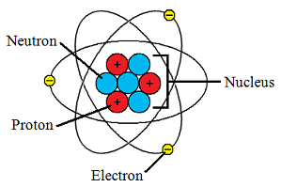
How did atomic theory develop?
Democritus used the word atomos, meaning “uncuttable,” for these smallest possible pieces.
In modern terms, an atom is the smallest particle that still can be considered an element.

Slide 5
How did atomic theory develop?
Atomic theory grew as a series of models that developed from experimental evidence. As more evidence was collected, the theory and models were revised.

Slide 6
Dalton’s Atomic Theory
Using evidence from many experiments, John Dalton, an English chemist, inferred that atoms had certain characteristics.
Dalton thought that atoms were like smooth, hard balls that could not be broken into smaller pieces.
Partner read page 145 do the figure one question and read the figure

Slide 7
Thomson’s Model
In 1897, J.J. Thomson discovered that atoms contain negatively charged particles called electrons.
Partner read first half of pg 146 and answer figure 2 question

Slide 8
Rutherford’s Model
In 1911, one of Thomson’s former students, Rutherford, found evidence that challenged Thomson’s model.

Slide 9
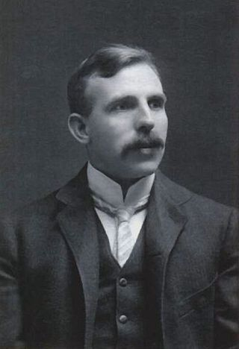
Rutherford
Rutherford inferred that an atom’s positive charge must be packed within a small region in its center, called the nucleus.
Later research suggested that the nucleus was made up of one or more positively charged particles. Rutherford called the positively charged particles in an atom’s nucleus protons.

Slide 10
Bohr’s Model
Niels Bohr (a student of Rutherford), a Danish scientist.
In 1913, Bohr suggested that electrons are found only in specific orbits around the nucleus.
Looked like planets orbiting the sun or the rings of a tree.
Each possible electron orbit in Bohr’s model has a fixed energy.

Slide 11
Cloud Model
In the 1920s, the atomic model changed again.
Scientists determined that electrons do not orbit the nucleus like planets, as Bohr suggested. Instead, electrons move rapidly within a cloudlike region around the nucleus
An electron’s movement is related to its energy level, or the specific amount of energy it has

Slide 12
Partner read 147-148
Answer 1a,b, and c on page 148

Slide 13
What is the modern model of the atom?
In 1932, James Chadwick showed that another particle exists in the nucleus of atoms.
This particle, called a neutron, was hard to find because it has no electric charge.

Slide 14
What is the modern model of the atom?
At the center of the atom is a tiny, dense nucleus containing protons and neutrons. Surrounding the nucleus is a cloudlike region of moving electrons.
Most of an atom’s volume is the space in which the electrons move.

Slide 15
What is the modern model of the atom?
Protons are shown by a plus sign +
Electrons are shown by the symbol eˉ
Protons have a charge of +1
Electrons have a charge of -1

Slide 16
149 figure 7

Slide 17
Highlights pg 150-151

Slide 18
Organizing the Elements
As a group work on the my planet diary pg 152

Slide 19
Mendeleev’s work
Mendeleev saw that some elements had similar chemical and physical properties.
He thought these similarities were important clues to a hidden pattern.

Slide 20
Mendeleev’s work
To find the pattern, Mendeleev wrote each element’s melting point, density, and color on an individual card
The atomic mass of an element is the average mass of all the isotopes of that element.
Then he went to work arranging

Slide 21
Mendeleev’s work
Mendeleev noticed that a pattern of properties appeared when he arranged the elements in order of increasing atomic mass.
He found that the properties repeated regularly.

Slide 22
Partner read pg 153 and complete the figure 1 question

Slide 23
The periodic table
Mendeleev created the first periodic table in 1869.
A periodic table is an arrangement of elements showing the repeating pattern of their properties.

Slide 24
The periodic table
As scientists discovered new elements and learned more about atomic structure, the periodic table changed.

Slide 25
The periodic table project

Slide 26
Lesson 3 starts here
Lesson 3 pg 160 my planet diary

Slide 27
What are the properties of Metals?
Elements can be classified by their properties, including melting temperature, density, hardness, and thermal and electrical conductivity.
Metals are elements that are good conductors of electric current and heat.

Slide 28
What are the properties of Metals? Con’d
Metals tend to be shiny and bendable (like copper wire).
The majority of elements in the periodic table are metals
The metals begin on the left side and extend across the periodic table

Slide 29
Physical Properties
The physical properties of metals include luster, malleability, ductility, and conductivity.
Luster – something's shiny and reflectiveness.
Malleable – material is one that can be hammered or rolled into flat sheets or other shapes

Slide 30
Physical Properties
A ductile material is one that can be pulled out, or drawn, into long wires. Copper is both malleable and ductile. (sheets or wires)

Slide 31
Physical Properties
Thermal conductivity is the ability of an object to transfer heat. The ability of an object to carry electric current is called electrical conductivity.

Slide 32
Physical Properties
Most metals are good thermal conductors and electrical conductors.
Some metals are magnetic.
Only mercury is a liquid at room temperature.

Slide 33
Chemical properties
The ease and speed with which an element combines, or reacts, with other substances is called its reactivity.
Metals usually react by losing electrons to other atoms.

Slide 34
Chemical properties
The deterioration of a metal due to a chemical reaction in the environment is called corrosion.

